Slide 1
Reimagining [Local Boutique] website -
An Usability Analysis for a Fashion Destination
Name ; KAARNIKA RACHEAL S
Course/Subject ; UI /UX INTERNSHIP

Slide 2
Importance of an E-commerce Website
Digital storefront for the business
Helps customers browse and shop online
Builds brand credibility
Increases sales opportunities
About [Local Boutique]
Local fashion retailer selling clothing and accessories
Uses its website to showcase products and attract customers
Important platform for online shopping and marketing

Slide 3

Existing Problems
Key Usability Issues
Cluttered homepage
Confusing navigation menu
Unclear product descriptions
Poor product organization
Difficult checkout process
Limited mobile responsiveness
Impact on Users
Hard to find products
Frustrating shopping experience
Increased cart abandonment

Slide 4
Heuristic
Heuristic Evaluation (Nielsen's Heuristics)
Problem Identified
Visibility of System Status
Consistency & Standards
Recognition Rather Than Recall
Error Prevention
Aesthetic & Minimalist Design
Help & Documentation
No loading feedback
Inconsistent buttons
Hidden navigation
Weak form validation
Overcrowded layout
No support section
Finding
The website does not provide a smooth and intuitive user experience

Slide 5
Recommended Improvements
✅ Simplify navigation ✅ Add search and filter options
✅ Streamline checkout process ✅ Create mobile-friendly layouts
✅ Organize products into clear categories ✅ Improve product descriptions
✅ Add customer support section

Slide 6
Homepage Wireframe
Wireframes (Redesigned Layout)
Product Page Wireframe
LOGO | SEARCH | CART
HOME | WOMEN | MEN | SALE | CONTACT
HERO BANNER
FEATURED PRODUCTS
BEST SELLERS
CUSTOMER REVIEWS
FOOTER
PRODUCT IMAGE | PRODUCT DETAILS
DESCRIPTION
ADD TO CART
RELATED PRODUCTS
REVIEWS

Slide 7
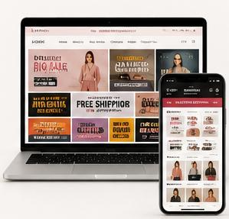
Expected Benefits
For Customers
Easier navigation
Faster product discovery
Better shopping experience
For Business
Increased sales
Higher customer satisfaction
Reduced cart abandonment
Improved brand reputation

Slide 8

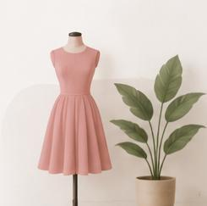
Final Statement
By applying usability principles and redesigning key areas of the website, Local Boutique can create a more engaging shopping experience that drives customer satisfaction and business growth. 🚀
THANK YOU

